Slide 1
Toward a Calculus for Reasoning about System Trustworthiness December 12, 2017 Imperial College London
A Workshop sponsored by the
US National Institute of Standards and Technology
and
Imperial College London

Slide 2
Agenda
Registration/Networking Coffee (8:30am to 9:00am)
Presentations (9:00am to 11:00am)
Security and Trustworthiness (C. Vishik, Intel)
CPS Framework (E. Griffor, NIST)
Break (10am to 10:15 am)
Trust Language, Satisfiability and Uncertainty (M. Huth, Imperial College London)
Short Presentations and Discussion (11am to 11:45am)
CPS/IoT Key Performance Indicator Frameworks (J. Tan)
Trust and Security for Sensor Actuator Networks (J. McCann)
Discussion
Lunch (11:45am to 12:30pm)
Presentations (12:30pm to 3:00pm)
Ontologies, Reasoning and AI (M. Balduccini, E. Griffor, C. Vishik)
Modeling the CPS Framework (E. Griffor)
CPS Framework and Trustworthiness Ontology (M. Balduccini and C. Vishik)
Break (1:45pm to 2:00pm)
Reasoning over Trustworthiness (M. Balduccini)
Discussion of ‘CPS Framework Modeling and Applications’
Short Presentations and Discussion (3:00pm to 3:45pm)
Security of Future Transport Systems (Carsten Maple, Warwick Manuf. Group)
Decidable Precision Reasoning over the Real Number (M. Huth)
Discussion
Closing (3:45pm to 4:00pm)

Slide 3
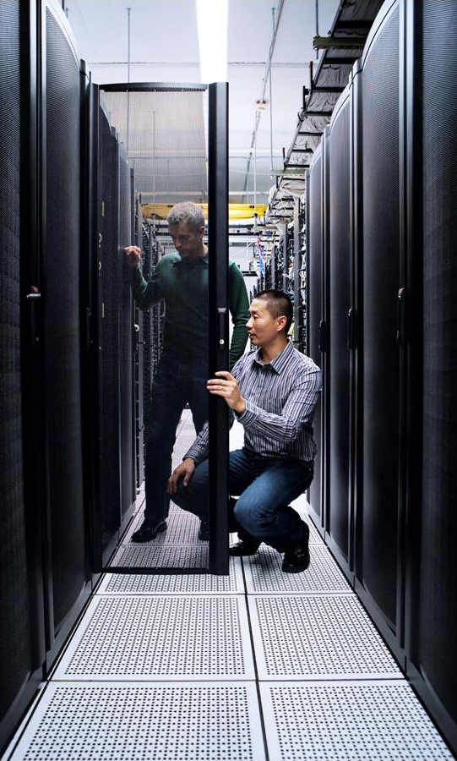
From Security to Trustworthiness - Vishik

Slide 4
Reach of cyberattacks is expanding
Adequate protection mechanisms have to include privacy,
safety, security, and other areas (reliability, resilience) treated in an
Integrated fashion
Server, PC, Mobile
Server, PC, Mobile, ICS, auto
Stuxnet
Duqu
GSM interface attack
Steel plant attack
Ransomware
Heart Bleed
Server attacks
Code Red
Sasser
SQL Slammer
Cabir Premium
Creeper



1970s
1980-90s
2000-2005
2005-2010
2010-2017
2017+
Server, PC
Server, PC, Mobile, ICS
Future
Brain
Morris Worm
Michelangelo
Leandro
Tribe Flood DDOS
Melissa



Further expansion
Confliker
ICS-CERT
I Love You
CAESS

Slide 5
Trustworthiness: integrated concept From NIST CPS Framework (https://s3.amazonaws.com/nist-sgcps/cpspwg/files/pwgglobal/CPS_PWG_Framework_for_Cyber_Physical_Systems_Release_1_0Final.pdf_
Safety
Ability to ensure the absence of catastrophic consequences on the life, health, property, or data of stakeholders
Security
Internal or external protection from unintended and unauthorized access, change, damage, destruction, or use of systems
Privacy
Risks to individuals arising from the processing of their personal information
Reliability
Ability to deliver stable and predictable performance in expected conditions
Resilience
Ability of withstand instability, unexpected conditions, and gracefully return to predictable, but possibly degraded, performance.
Definition: Demonstrable likelihood that the system performs according to designed behavior under a typical set of conditions as evidenced by its characteristics, such as safety, security, privacy, reliability and resilience.

Slide 6
Integrated trustworthiness: sample categories of use cases
Modeling
Use the integrated approach to model current and future systems and complex environments
Design and development
Anticipate connections, features, and constraints in designing CPS
Analysis and assessment
Assess existing systems to understand their potential vulnerabilities and to optimize deployment
Notes:
For technical standards, a lot of work is already done. We need to enhance global participation, ensure global awareness and improve approaches that are already available. Because standardization is a volunteer endeavor in most organizations, ensuring global participation of experts to ensure we have right expertise will both socialize standard technologies and improve the quality of deliverables.
Governance standards represent an important opportunity. They are embraced by a segment of the technology community, but applicability can be much broader. And, in many environments, there is also a body of best practices that serve as de-facto standards, but have limited reach. An important priority is to make sure standards and best practices play a strong role in cybersecurity processes worldwide.
Fragmentation of effort and expertise is a serious danger. With cybersecurity expertise is rate and valuable, we need to stress the global nature of cybersecurity standardization endeavors.
Hand in had with this goal comes a priority to harmonize approaches across the globe, to ensure predictable levels of protection and interoperability.

Slide 7
Integrated trustworthiness: some challenges
Misalignment of metrics
Even for probabilistic models, the values for failure rates for, e.g., security and safety are very different
Mutually exclusive requirements
Requirements for adjacent areas are misaligned. E.g., transparency requirements are fundamentally different for security and privacy
No mechanism for composition
No reliable tools to model a component in context, e.g., autonomous vehicle in a Smart City
Notes:
For technical standards, a lot of work is already done. We need to enhance global participation, ensure global awareness and improve approaches that are already available. Because standardization is a volunteer endeavor in most organizations, ensuring global participation of experts to ensure we have right expertise will both socialize standard technologies and improve the quality of deliverables.
Governance standards represent an important opportunity. They are embraced by a segment of the technology community, but applicability can be much broader. And, in many environments, there is also a body of best practices that serve as de-facto standards, but have limited reach. An important priority is to make sure standards and best practices play a strong role in cybersecurity processes worldwide.
Fragmentation of effort and expertise is a serious danger. With cybersecurity expertise is rate and valuable, we need to stress the global nature of cybersecurity standardization endeavors.
Hand in had with this goal comes a priority to harmonize approaches across the globe, to ensure predictable levels of protection and interoperability.

Slide 8
Next steps: from TW positioning to ontology & reasoning
Current state
CPS framework positions trustworthiness within CPS and allows the technologists to decompose this concept
Ontology and reasoning
Future work needs to create a trustworthiness ontology matching the current CPS framework and reasoning algorithms to analyze trustworthiness
Trust language
Trust language will need to be developed as a tool for trustworthiness calculus (building on existing ‘reasoning languages’ such as OCL, OWL, etc.)
Notes:
For technical standards, a lot of work is already done. We need to enhance global participation, ensure global awareness and improve approaches that are already available. Because standardization is a volunteer endeavor in most organizations, ensuring global participation of experts to ensure we have right expertise will both socialize standard technologies and improve the quality of deliverables.
Governance standards represent an important opportunity. They are embraced by a segment of the technology community, but applicability can be much broader. And, in many environments, there is also a body of best practices that serve as de-facto standards, but have limited reach. An important priority is to make sure standards and best practices play a strong role in cybersecurity processes worldwide.
Fragmentation of effort and expertise is a serious danger. With cybersecurity expertise is rate and valuable, we need to stress the global nature of cybersecurity standardization endeavors.
Hand in had with this goal comes a priority to harmonize approaches across the globe, to ensure predictable levels of protection and interoperability.

Slide 9
Useful concept: trust evidence Ability to rely on a broader list of characteristics (evidence) to assess trustworthiness. Some examples below.
Trust posture
Nuanced rather than black & white approach to trust
Identification
Provable device identification, proof of ownership, provable transaction identification
Measurement
Verified proof of domain integrity and software integrity, integrity measurement, time stamp
Evaluation
Evidence of self certification & evaluation, conformance to standards, data quality
Configuration
Proof of the integrity of configurations; up-to-date maintenance record
Definition: trust evidence is an agreed upon system of parameters that could help define trustworthiness in a complex environment

Slide 10
Relevant area: human/technology connection
Intent semantics
The intent of the user or developer while designing and using a system
Usability
Ease, with which a system can be used, learned, and integrated into an environment or process
Transparency
Ease, with which a system can be understood for functions that a user or other systems need to know
Although the majority of interactions are machine to machine, the human aspect is very important!
Notes:
For technical standards, a lot of work is already done. We need to enhance global participation, ensure global awareness and improve approaches that are already available. Because standardization is a volunteer endeavor in most organizations, ensuring global participation of experts to ensure we have right expertise will both socialize standard technologies and improve the quality of deliverables.
Governance standards represent an important opportunity. They are embraced by a segment of the technology community, but applicability can be much broader. And, in many environments, there is also a body of best practices that serve as de-facto standards, but have limited reach. An important priority is to make sure standards and best practices play a strong role in cybersecurity processes worldwide.
Fragmentation of effort and expertise is a serious danger. With cybersecurity expertise is rate and valuable, we need to stress the global nature of cybersecurity standardization endeavors.
Hand in had with this goal comes a priority to harmonize approaches across the globe, to ensure predictable levels of protection and interoperability.

Slide 11
CPS Framework - Griffor

Slide 12
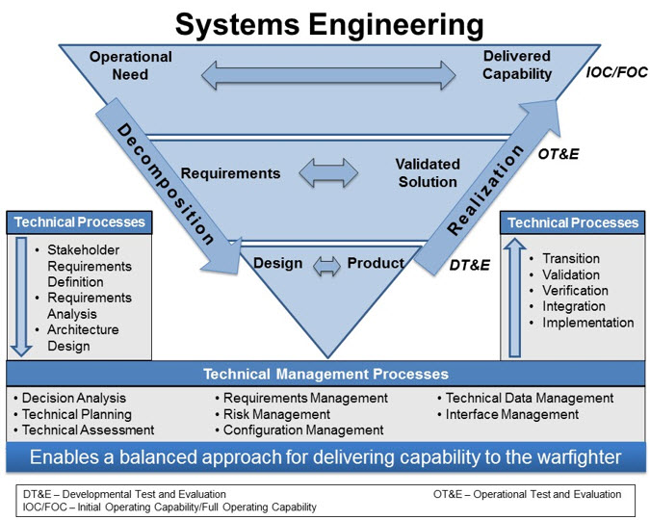
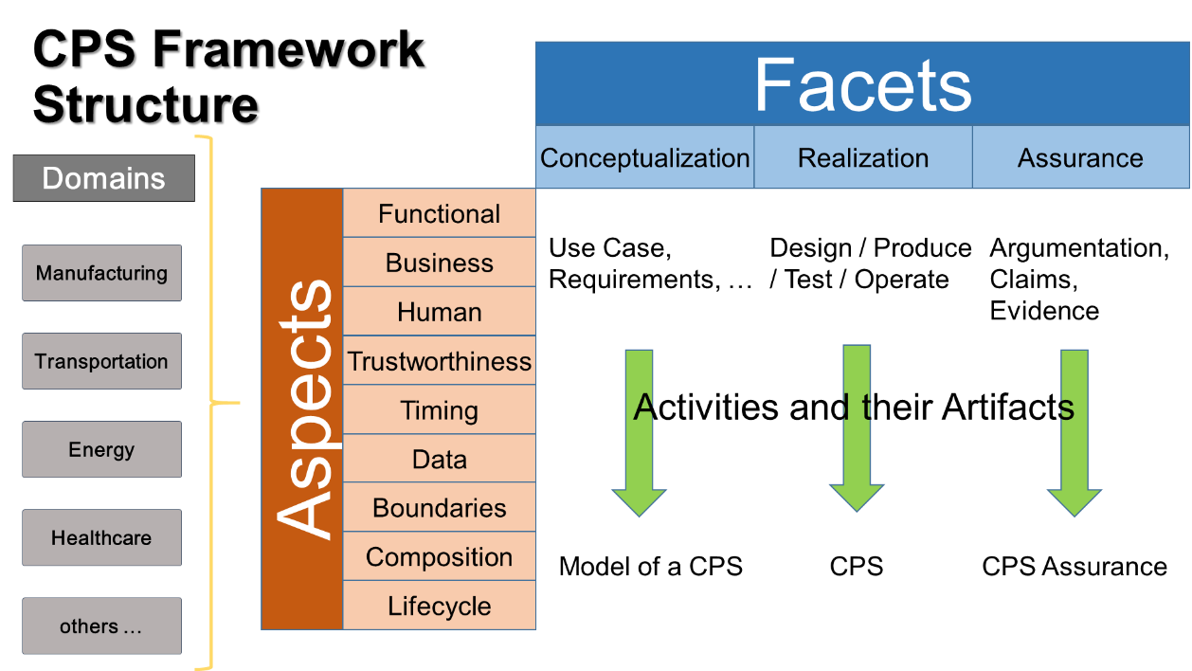
Workshop Goals
This workshop aims to promote discussion around CPS trustworthiness as it relates to how we conceive, design, build, deliver and maintain these systems.
CPS Framework
What is CPS?
How do we design, build and assure CPS throughout their lifecycle?
What discipline do we need to address the concerns that drive requirements and engineering?
What needs to be the common core tooling?
Dashboard for Continuous Integration of CPS Development

Slide 13
2. Welcome
NIST and the Smart Grid and Cyber-Physical Systems Program Office – CPS Program
CPS Framework
CPS Framework Open Source: Continuous Integration for CPS Development

Slide 14
3.1 What is a cyber-physical system (CPS)?
Cyber-Physical Systems comprise interacting digital, analog, physical, and human components engineered for function through integrated logic and physics.
Internet of Things (IoT) emphasizes digital infrastructure for widely connected, interacting, physical ‘things,’ forming systems that integrate logic and physics for function.
NIST Smart Grid and Cyber-Physical Systems Program Office

Slide 15
3.2 How do we design, build and test CPS?
Develop requirements.
Specify the system, sub-systems and components.
Build components.
Unit test components.
Assemble and test sub-systems.
Assemble and test/validate full system.

Slide 16
3.3 What discipline do we need to address the concerns?
Concern Structure:
Develop a full set of concerns.
Develop the relationships between the concerns.
Systems Engineering
Activities:
Determine requirements needed to address each concern.
Design, build and test to each set. (composition of concerns).
Build the Assurance Case

Slide 17
3.4 What needs to be the common core tooling?
CPS Framework Open Source provides:
‘Type Structure’ for:
Aspects and concern; and
Facets, engineering activities and outcomes
That type and sort compositionally:
properties/requirements and
artifacts
Encoded in a portable, reusable XML format.
Continuous Integration for CPS Development

Slide 18
3.5 Expanded Concern Risk and Risk Mitigation Surface
Primary Impact of Failure
Digital | Physical
Mitigation Mechanisms
Digital | Analog | Physical
IT System
CPS
“E.g. Better cybersecurity through physics!”

Slide 19
CPS Framework Background

Slide 20








Frameworks – NIST Convening of Stakeholders
2008
2009
2010
2011
2012
2013
2014
2015
2016
Smart Grid
Dec 2007
EISA SG Legislation
Cloud Computing
2010
Cybersecurity
Feb 2013
Executive Order
Community Disaster Resilience
June 2013
Climate Action Plan
Perspectives, Viewpoints, Views, …
Communities of practice, processes, …
Big Data
Frameworks: documented conceptual structures that organize and make clear collective wisdom (vision, principles, underlying structure, functions, requirements, …)
Frameworks are created with technical expertise and consensus-based process
June 2013
Smart America/Global Cities
Cyber-Physical Systems
June 2014

Slide 21
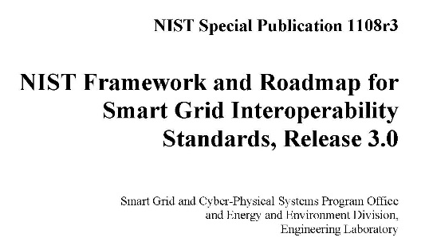
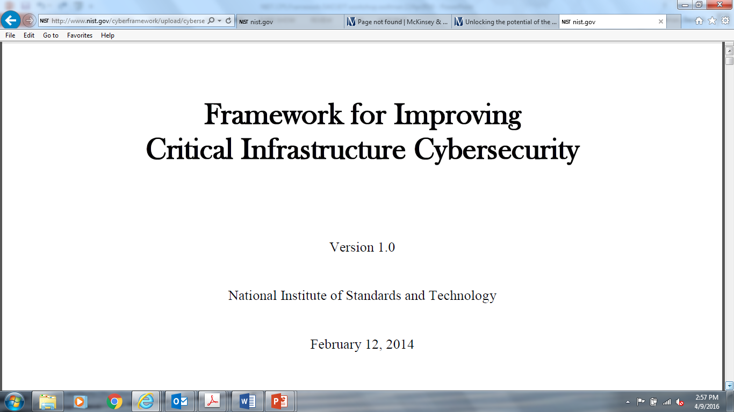
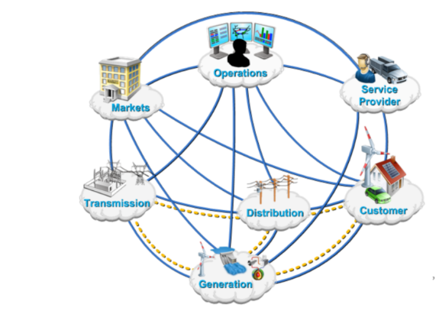

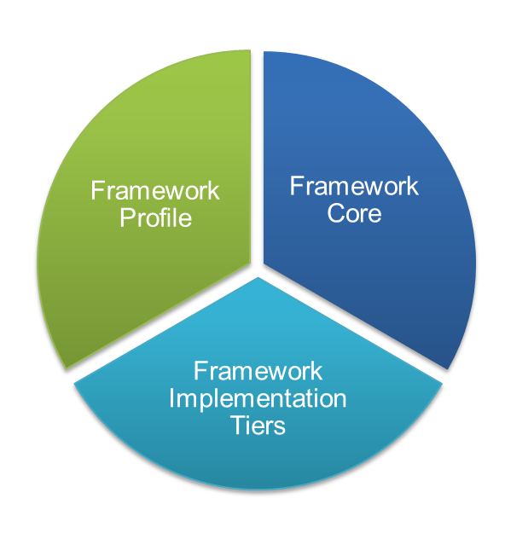
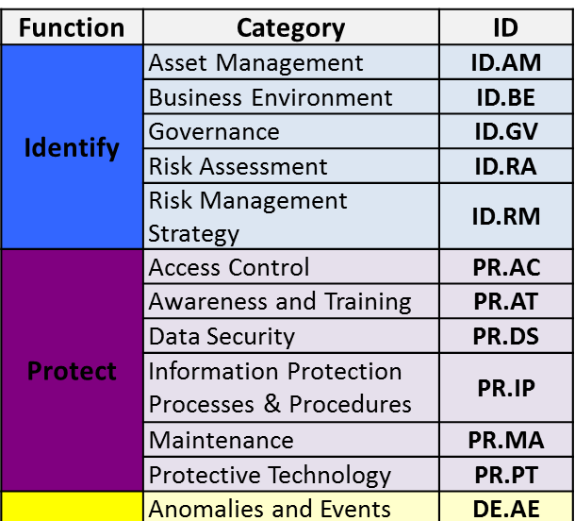
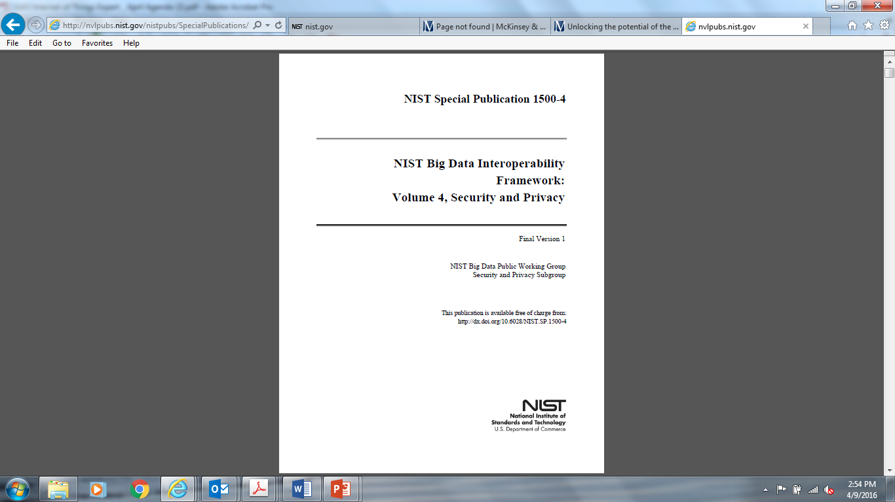
Frameworks – NIST Convening of Stakeholders
2008
2009
2010
2011
2012
2013
2014
2015
2016
Smart Grid
Dec 2007
EISA SG Legislation
Cloud Computing
2010
Cybersecurity
Feb 2013
Executive Order
Community Disaster Resilience
June 2013
Climate Action Plan
Big Data
June 2013
Priority Action Plans (PAPs)
Smart America/Global Cities
Cyber-Physical Systems
June 2014

Slide 22
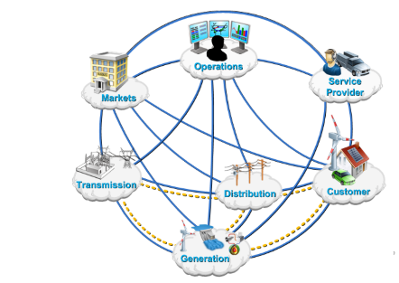
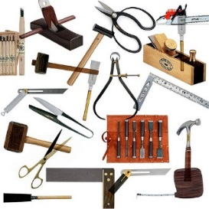
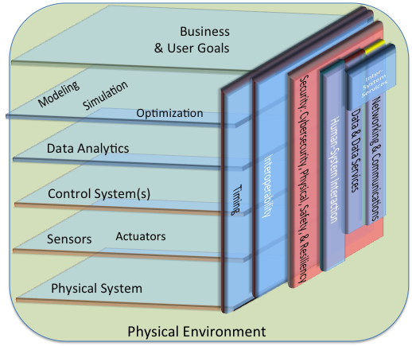
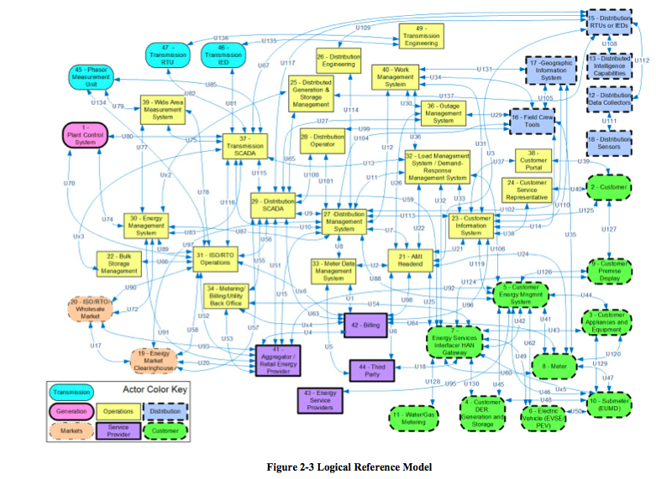
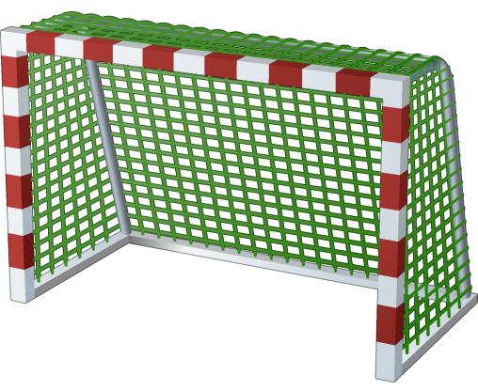




NIST CPS Public Working Group
Goal: create CPS Framework to support CPS research, development and deployment (applicable to CPS and Internet of Things IoT)
Need: multi-domain perspective baked in
Applicable within all CPS domains, supports cross-CPS domain applications
CPS Framework
Goals
achieve
CPS
Actors
use
Smart emergency response
Many more!!
Smart transportation
Smart infrastructure (grid, water, gas, …)
Smart buildings
Smart healthcare
Smart manufacturing

Slide 23
NIST CPS Public Working Group
NIST CPS PWG leadership: David Wollman and Chris Greer
Co-Chairs | Reference Arch | Use Cases | Security | Timing | Data Interop
NIST | Abdella Battou, Ed Griffor | Eric Simmon | Vicky Pillitteri, Steve Quinn | Marc Weiss | Marty Burns
Academia | Janos Sztipanovits | John Baras | Bill Sanders | Hugh Melvin | Larry Lannom
Industry | Stephen Mellor, Shi-Wan Lin | Stephen Mellor | Claire Vishik | Sundeep Chandhoke | Peggy Irelan, Eve Schooler
NIST SP 1500-201 and 1500-202
Co-Leads: Ed Griffor, Dave Wollman, Chris Greer
pages.nist.gov/cpspwg

Slide 24
5.5 CPS Framework Development
What things should be and what things are supposed to do
How things should be made and operate
CPS Framework
Conceptualization
Facet
Aspects and Concerns
Model of CPS
CPS Stakeholders
(Societal, Business & Technical)
Raw CPS concerns
Realization
Facet
Assured CPS
Instance of CPS
Assurance
Facet
CPS Assurance
How to prove things actually work the way they should

Slide 25
5.6 NIST CPS PWG – CPS Framework
‘Concern-driven’: holistic, integrated approach to CPS/IoT concerns.
CPS Framework Release 1.0 (May2016) available at https://pages.nist.gov/cpspwg/

Slide 26
5.7 Purpose of the CPS Framework
Concern-driven structuring of development artifacts: to facilitate assurance cases (by representing or analyzing a system along these dimensions, points of commonality or interoperability with other systems are revealed)
A normal-form for CPS/IoT system (common way of presenting CPS/IoT that enables comparison of what is done, across the system, for the sake of any individual concern)
Provides a method for integrating CPS/IoT across domains – the future of CPS/IoT is cross-domain integration. While some domains may have robust, integrated approaches to some concerns, there are typically radically different standards across domains.
CPS Framework is NOT A PROCESS!! It is a method for integrating concerns into systems engineering processes!

Slide 27
5.9 CPS Framework Structure
Facets
Conceptualization
Realization
Assurance
Domains
Functional
Business
Use Case, Requirements, …
Design / Produce / Test / Operate
Argumentation, Claims, Evidence
Manufacturing
Human
Transportation
Trustworthiness
Aspects
Activities and their Artifacts
Timing
Energy
Data
Boundaries
Healthcare
Composition
Model of a CPS
CPS
CPS Assurance
Lifecycle
others …

Slide 28
Aspects (groupings/categories of concerns)
Functional | Concerns about function including sensing, actuation, control, communications, physicality, etc.
Business | Concerns about enterprise, time to market, environment, regulation, cost, etc.
Human | Concerns about human interaction with and as part of a CPS.
Trustworthiness | Concerns about trustworthiness of CPS including security/cybersecurity, privacy, safety, reliability, and resilience.
Timing | Concerns about time and frequency in CPS, including the generation and transport of time and frequency signals, timestamping, managing latency, timing composability, etc.
Data | Concerns about data interoperability including fusion, metadata, type, identity, etc.
Boundaries | Concerns related to demarcations of topological, functional, organizational, or other forms of interactions.
Composition | Concerns related to the ability to compute selected properties of a component assembly from the properties of its components. Compositionality requires components that are composable: they do not change their properties in an assembly. Timing composability is particularly difficult.
Lifecycle | Concerns about the lifecycle of CPS including its components.

Slide 29
Activities and Artifacts
Model of CPS
Conceptualization Activities
CPS
In using the framework to analyze and document CPS, a series of activities is performed. For example, a typical waterfall-like process will include:
use case development
functional decomposition
requirements analysis
design
etc.
An activity produces one or more artifacts.
Realization Activities
Conceptualization Facet
Realization Facet
CPS Assurance
Assurance Activities
Assurance Facet
For example, the activities and associated artifacts of the conceptualization facet commonly include:
Mission and Business Case Development
Artifact: Business use cases
Functional Decomposition
Artifact: Detailed use cases, actors, information exchanges
Requirements Analysis
Artifact: Functional and non-functional requirements
Requirements Allocation
Artifact: HW/SW configuration Items
Interface Requirements Analysis
Artifact: Interface requirements

Slide 30
Analyzing and Developing CPS: Decomposition
Safety “Properties” of a Function: Automatic Emergency Braking (AEB)
CPS/Function Types
Business Case
Vehicle provides automated collision safety function
Use Case ‘feature’
Vehicle provides/maintains safe stopping
Functional Decomposition (Logical and Physical)
CPS
Braking function reacts as required
Logical
Stopping algorithm provides safe stopping
Functional Decomposition/Allocation
Messages
Messaging function receives distance to obstacles and speed from propulsion function
Info
Distance and speed info is understood by braking function
Physical
Influences
Friction function provides appropriate friction, depending on the road, tire pressure, etc.
Energy
*transductions
Apply Aspects/Concerns
Generate System Properties

Slide 31
6. Applications - Griffor
Mathematics of CPS and the CPS Framework (E. Griffor)
Applications to Transportation (D. McShane, F. Brandao/Ricardo LLC)
IES City Tables – CPS Framework as Benchmarking Tool (M. Burns)
From Security to Trustworthiness (C. Vishik/Intel)
Trustworthiness Ontology (M. Balduccini/St. Joseph’s University)

Slide 32
6.1.2 The Category CyPhy
The cyber-physical category CyPhy has as objects:
Action/Actuation
Sense
Phys_State
Decision
The morphisms of CyPhy are given by:
Mor(Act,Physical_State) = {phy_act-phys}
Mor(Decision,Act) = {log_dec-act}
Mor(Sense,Decision) = {log_sen-dec}
Mor(Sense,Act) = {phys_sen-act}
Mor(Phys_State,Sense) = {phy_Phys_State-Sense}.

Slide 33
6.1.3 Symmetric Monoidal Categories
For purposes here systems will be viewed as processes and interactions between them (process algebra in the sense of Milnor for example)
We distinguish two sorts of interactions between processes:
Logical interactions (exchanges of information)
Physical interactions (exchanges of energy)
Math model of physical interactions is algebraic systems of ODEs
Math model of logical interactions are formalizations of agent-based models such as complex adaptive systems (J. Holland)
We choose symmetric monoidal categories (SMC) as an example of a model of systems in category

Slide 34
6.1.4 CPS as Functors
A cyber-physical system, in the sense of process algebra, can be represented as a functor from a symmetric monoidal category to the category CyPhy.
Such a functor represents:
Processes as instances of Sensing, Decision, Action or Physical
Interactions as exchanges of information or exchanges of energy
Benefit of this representation can be derived from:
Structural representation of one CPS ‘in another’ (isomorphic with a sub-CPS)

Slide 35
6.1.5 The category CPS
Given two representations of CPS as functors F and G, let SM(F)/SM(G) denote the symmetric monoidal categories that F and G map into CyPhy
Mor(F,G) is the functors T from SM(F) to SM(G) such that the following diagram commutes:
T
SM(F)
SM(G)
F
G
CyPhy

Slide 36
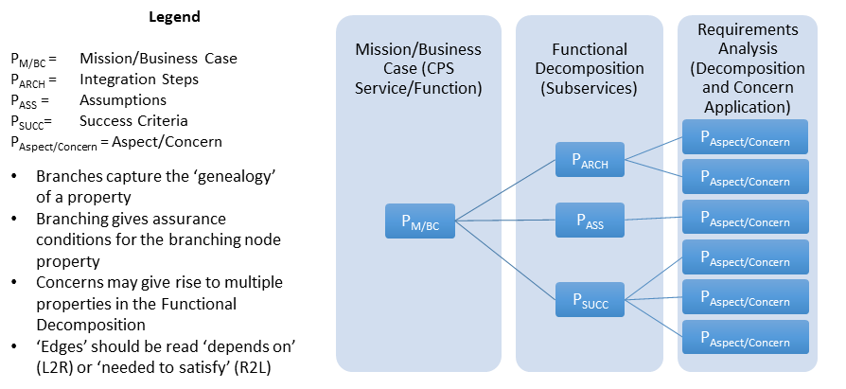
6.1.6 Mathematics of CPS Framework
Property-Tree of a CPS
Semantics of CPS Framework
… defines composition of concerns
Formal Methods for Assurance of a CPS

Slide 37
6.2 Applications to Transportation – McShane/Brandao

Slide 38


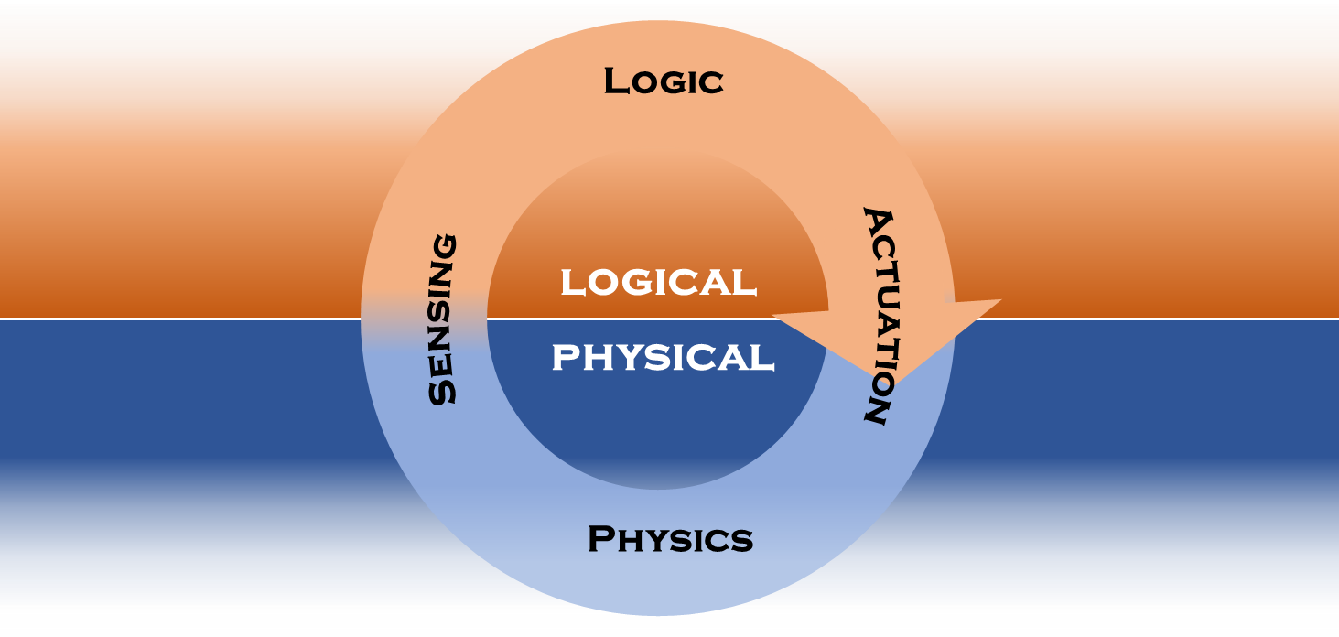



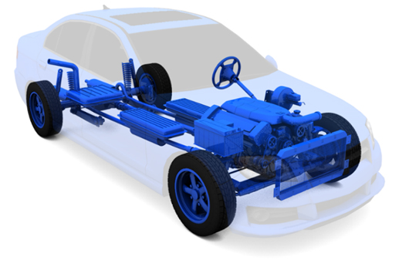
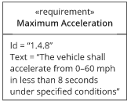

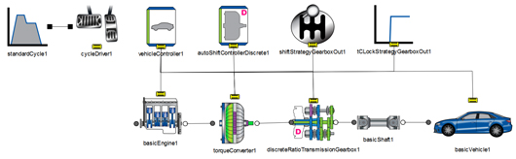

6.2.5 Automotive Use Case Setup
CPS
Requirements
/ Standards
System
Performance reports
Pass/Fail checklists
Typical Development Process

Slide 39
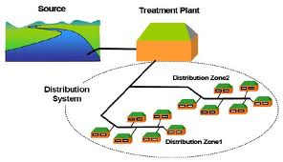
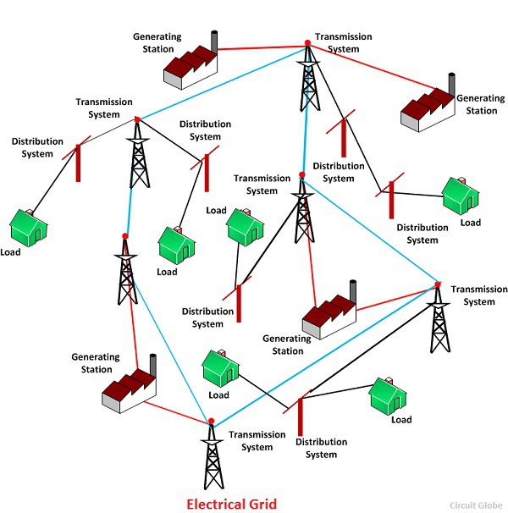
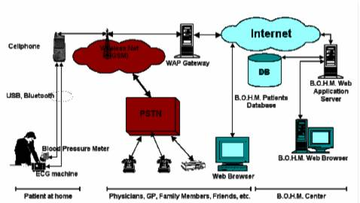
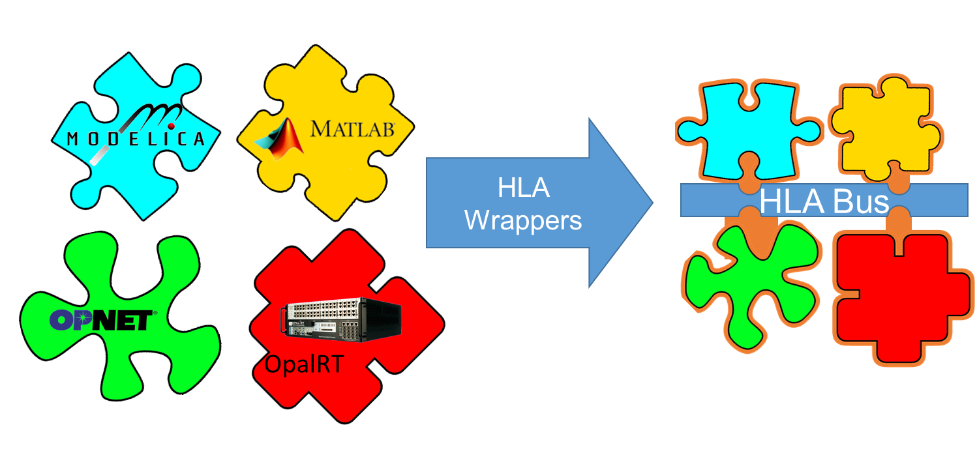
6.2.6 Use Case Setup - System
System can be:
Automotive
Water Process and Distribution System
Electrical Grid
Medical/Health System application
…
Diverse testbed options/configurations:
All virtual prototype using MiL and SiL
HiL system(s) at different phases of the development process
with emulated HW
HW as they are made available
Real-time
Sub-systems and components may have diverse ownership / suppliers
IP protections
On-board and off-board interactions and attacks
System

Slide 40
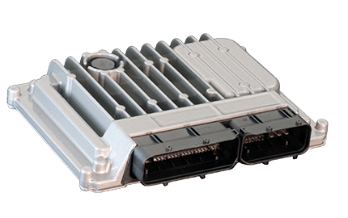
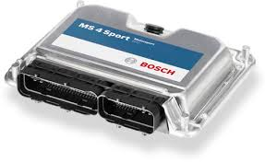

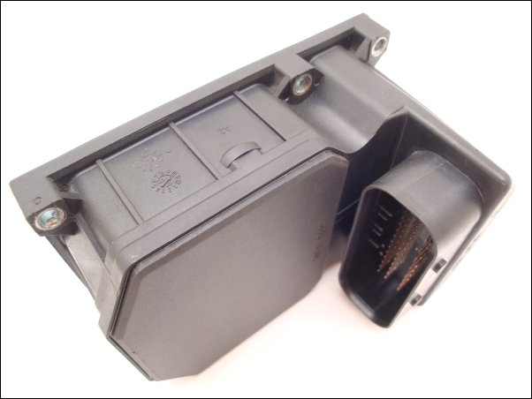
6.2.7 Sample of multiple control units’ communication
CAN / FLEXRAY
Local CAN
ECU
TCU
<<Actor>>
ESP
<<Actor>>
Notes:
ECU Bosch
TCU Tremec
ABS/ESP Bosch

Slide 41
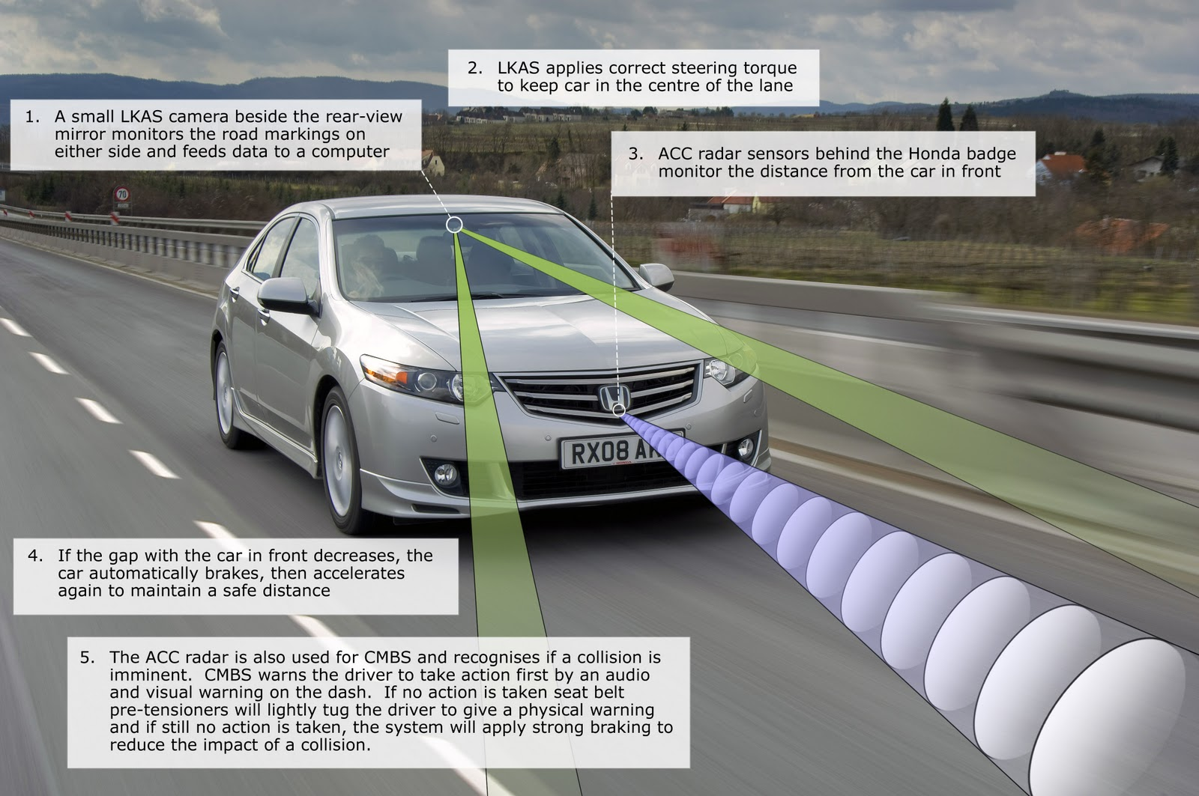
6.2.8 Automatic Emergency Braking - Example

Slide 42
Automotive System Functional Level: Brake System

Slide 43
Sub-System Behaviors: Brake System
Passive Braking – Basic functionality
Brake pressure applied no feedback (Open loop)
ABS – Avoid locking of wheels
Brake pressure applied, feedback based on wheel speed sensors (Closed loop)
Basic Stability control – not loosing control of vehicle due to braking, based on wheel speed and other sensors
Automated – Collision avoidance
Proximity sensors trigger braking event due to;
Car brakes by itself (Distracted Driver / reaction time)
Driver not braking soon enough or hard enough
Keep in the direction of travel, Systems controls steering and brake pressure
Similar to LKA

Slide 44
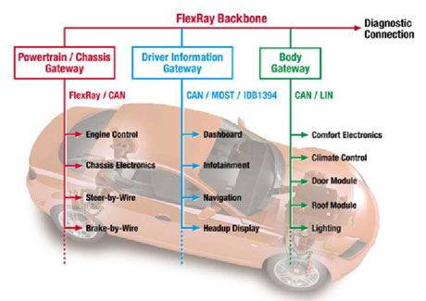
6.2.11 Demo Plan
State of the Art Vehicle Control Network
Concept:
Multiple control systems developed by different suppliers
Communication via CAN Bus using encrypted signals
Confidential/proprietary information passing.
Potential to be Hil /Sil or a combination of both
Federated experiments could be;
Cyber attack through the infotainment system or on-board component
Braking system Hardware malfunctions and doesn’t send the correct signals
Reference: http://ercim-news.ercim.eu/images/stories/EN87/hanzlik1.jpg
Notes:
Main content slide. Other slide layouts are available via Home tab > Slides group > Layout.
Edit the project number, confidential level (and client name), date and document number (RD or for proposals use B&T number) in the footer via View tab > Presentation Views group > Slide Master. Be sure to scroll all the way up to the top “slide master” to edit these, as you can not edit them in the “layouts”. Also go there to remove or edit the “INTERNAL UNAPPROVED DRAFT” tag before PDF’ing for releasing to clients.. Install the Ricardo Add-in for PowerPoint to automate this.

Slide 45
Ontologies ‘101’ - M. Balduccini

Slide 46
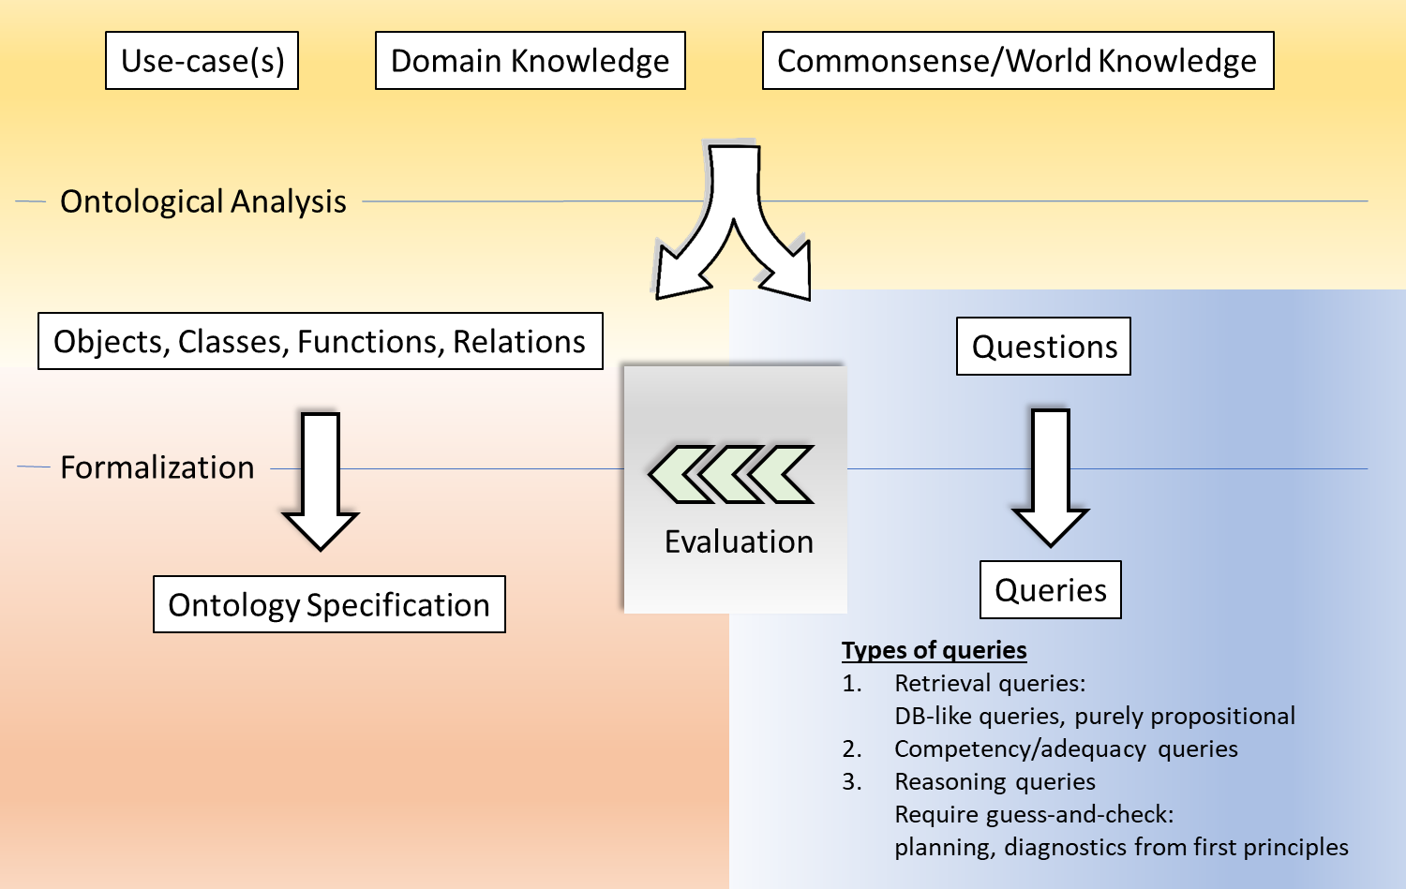
Modeling Methodology: Conceptual Ontology

Slide 47
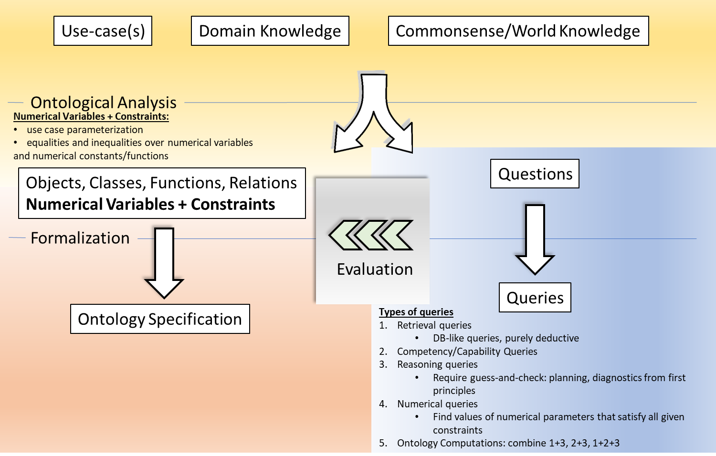
Modeling Methodology: Parametrization, Ontology Calculus

Slide 48
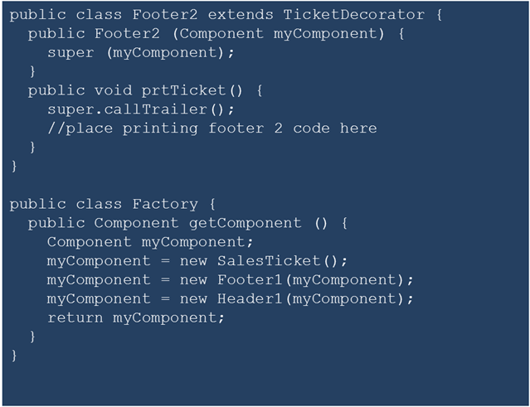
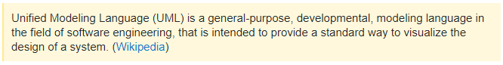
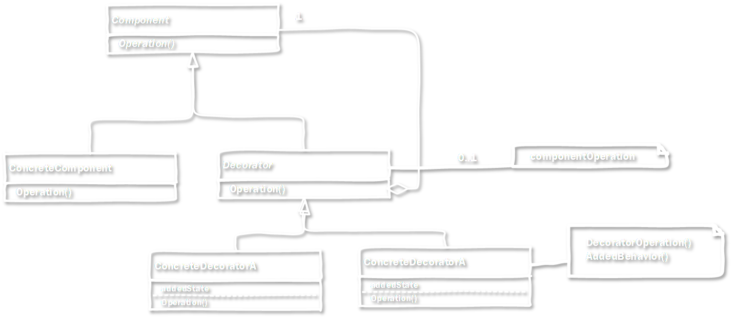
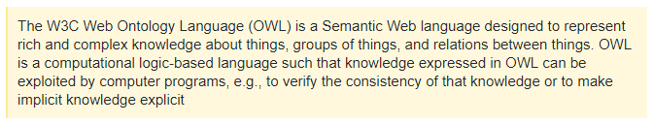
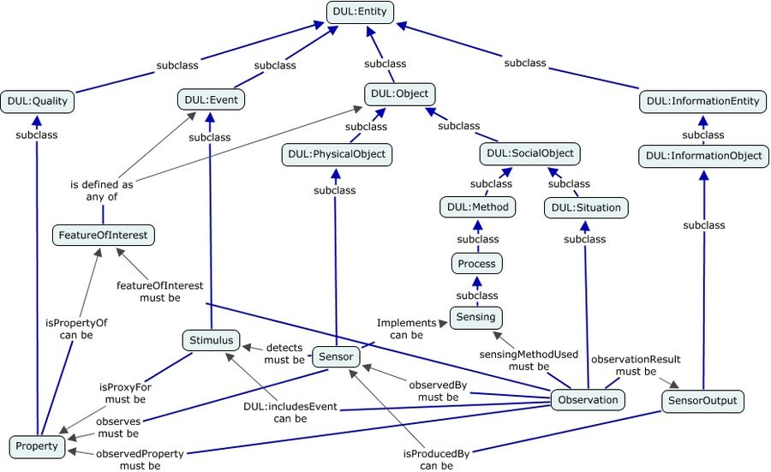
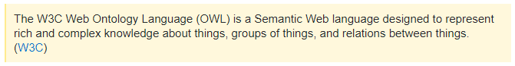
Modeling Tools
UML
Focus: systems, system design, code generation
Knowledge Representation (KR) Languages, OWL
Focus: “world” knowledge, commonsense, automated reasoning

Slide 49

Modeling Use-Case
Device
model
Police body cameras
Body cameras, location sensors, alarm sirens
Security
Physical Security: broken, stolen
Cyber Security: CIA of data streams
Important if used in court
Potential approach: timestamp
Privacy
Is face recognition in use?
Who has access to the information?
Reliability: will the camera work 24/7?
Data reliability:
Multiple cameras, multiple streams
Stored on a server
Who has access? Who can access all streams?
Resilience
What if a camera does not work?
Can the stream from a nearby camera be used as a substitute?
“Stitch camera feeds from home security systems”
Trustworthiness elements

Slide 50
Earlier Work: Cone-of-Impact Vulnerability Assessment

Slide 51
Systems Engineering and the CPS Framework

Slide 52
Our goals for the CPS Framework
CPS Framework does not replace systems engineering (SE) processes!
We believe that existing SE approaches do not explicitly consider the breadth of concerns required for CPS
The goal is to enhance existing systems engineering processes with a methodology to apply a rich set of concerns that are traceable throughout the CPS life cycle

Slide 53
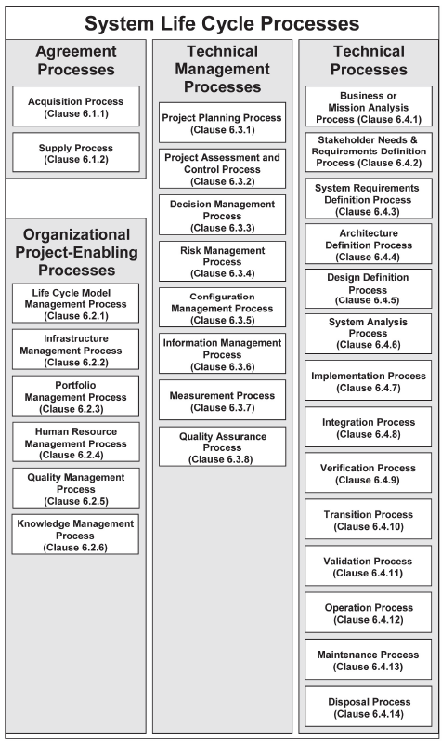
8.2 What is IEC 15288?
An international standard that describes “a common framework of process descriptions for describing the life cycle of systems created by humans”
Defines a set of processes that span the system life cycle separated into 4 categories (see right)
Each process description has: 1. a statement of purpose 2. a set of outcomes 3. a list of activities and their tasks
Source: ISO/IEC/IEEE 15288

Slide 54
IEC 15288 is designed to be adaptive
It does not prescribe a development methodology for the implementation of process descriptions in a project
It recommends using only the sub-set of relevant processes for a given system of interest
It defines a tailoring method to modify existing life cycle processes or create new processes

Slide 55
NIST SP 800-160
Special Publication on Systems Security Engineering

Slide 56
How can we build a trustworthy system?
15288 provides no guidance on what must be considered at each stage of the system life cycle to build a trustworthy system
Modern systems are too complex for concerns such as trustworthiness to be separated from the system life cycle processes
Trustworthiness is achieved by holistic consideration of multiple concerns during system engineering processes

Slide 57
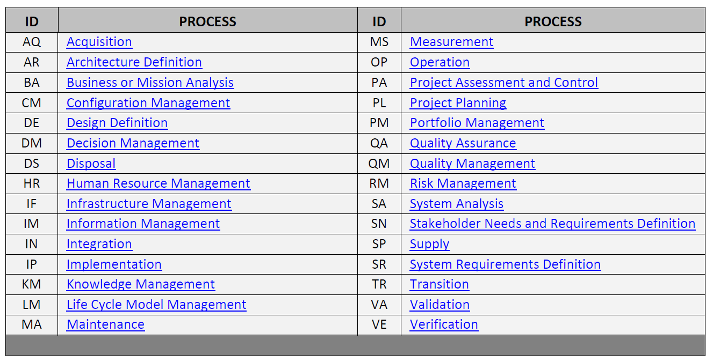
8.5 What is 800-160?
Tailors 15288 process descriptions (purpose, outcomes, and activities) to incorporate trustworthiness concerns
Source: NIST SP 800-160

Slide 58
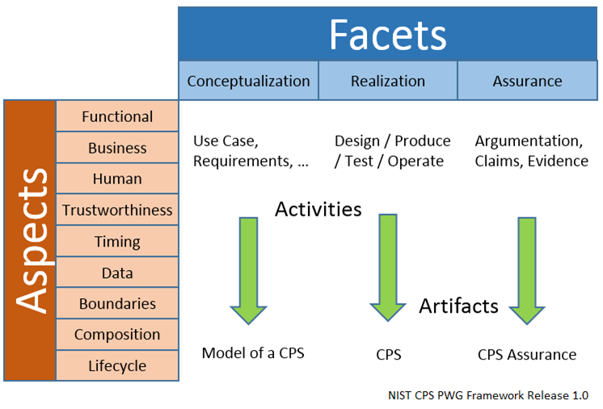
8.6 How does the CPS Framework fit?
15288
800-160

Slide 59
The need for a holistic approach
All CPS aspects/concerns intrinsically depend on each other and we need a holistic approach for such cross-cutting concerns
Examples:
Cyber security mechanisms can be defeated by physical attacks
The most secure system is one that does nothing
The dichotomy between being fast and secure and others

Slide 60
CPS Framework Open Source
The Road to a Development Process Tool

Slide 61
Current State
We need a holistic, concern-driven methodology for the development of CPS
We have multiple system engineering processes that provide an outline for how to develop a CPS
We have an ontology of cross-cutting concerns extracted from domain experts in CPS

Slide 62
Plan moving forward
CPS Framework satisfies our need at a conceptual level
There is still a gap on how to implement the framework:
How to annotate the artifacts (process outcomes) with concerns?
How to manage and exchange the artifacts that are produced?
How to trace concerns across artifacts throughout the life cycle?
We are working towards a tool and data exchange format to manage artifacts produced by 15288 / 800-160 / …

Slide 63
Modeling for a ‘CPS Framework Tool’
Moving the CPS Framework Forward
Use Case Methodology
Model Realization
Modeling the CPS Framework and Use Case
Tools Demonstration

Slide 64
Moving the CPS Framework Forward
We wanted to move adoption of the CPS Framework concepts into common practice in engineering CPS
We believe that the CPS Framework enhances and extends existing system engineering processes and does not alter or replace them
We hoped to quantify the discussion of CPS so that it can be studied from multiple disciplines
So we developed a useable model of the CPS Framework

Slide 65
CPS Framework Open Source Tools
System Artifacts and Data
High-level
Aspects/Concerns
Tool
A
CPS N
CEO
CIO
CTO
Tool
B
NIST CPS Framework
XML Model
Mgr.
CPS 2
Sr. Mgr.
Systems of Interest
DIR
Tool
C
Operational Leads
Eng
CPS 1
Tool
Z
Eng
Eng
Concerns &
Sys Properties
Tools have both scope and depth!

Slide 66
CPS Framework Model Requirements
Capture Concern-Driven Analysis
Support traceability of requirements, designs that realize them, tests that verify them, and argumentation that validates them
Allow for maturity and versioning of parts
Allow for reuse
composition of existing and new parts
Support referencing external artifacts and specifications
External documents and specifications
Standards and certification test references
Development process tool artifacts
Support reasoning over data set in single XML Document

Slide 67
Tech Transfer Concept
We built this model so it can accessorize existing tool suites for system engineering process execution
The result is a simple XML data file that can be an import or export to any tool
The data structure of the XML document object is composable so that various tools can add/edit detail at any time
The UML model and XMLSchema is provided as an open source tool set (more on this later) at:
https://github.com/usnistgov/cpsframework
We encourage interested parties to evolve this with us to suit your collective needs

Slide 68

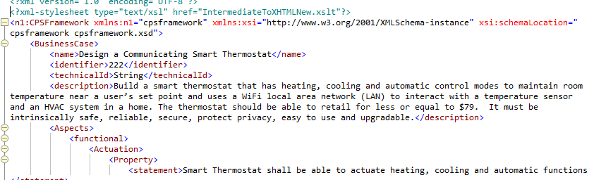
Evolution of CPS Design Instance
Tools for conceptualization, realization, and assurance of CPS
Requirements Capture
Design
Testing
Assurance
Configuration management
Continuous integration
CPS Framework Document Instance

Slide 69
And now the details ….

Slide 70
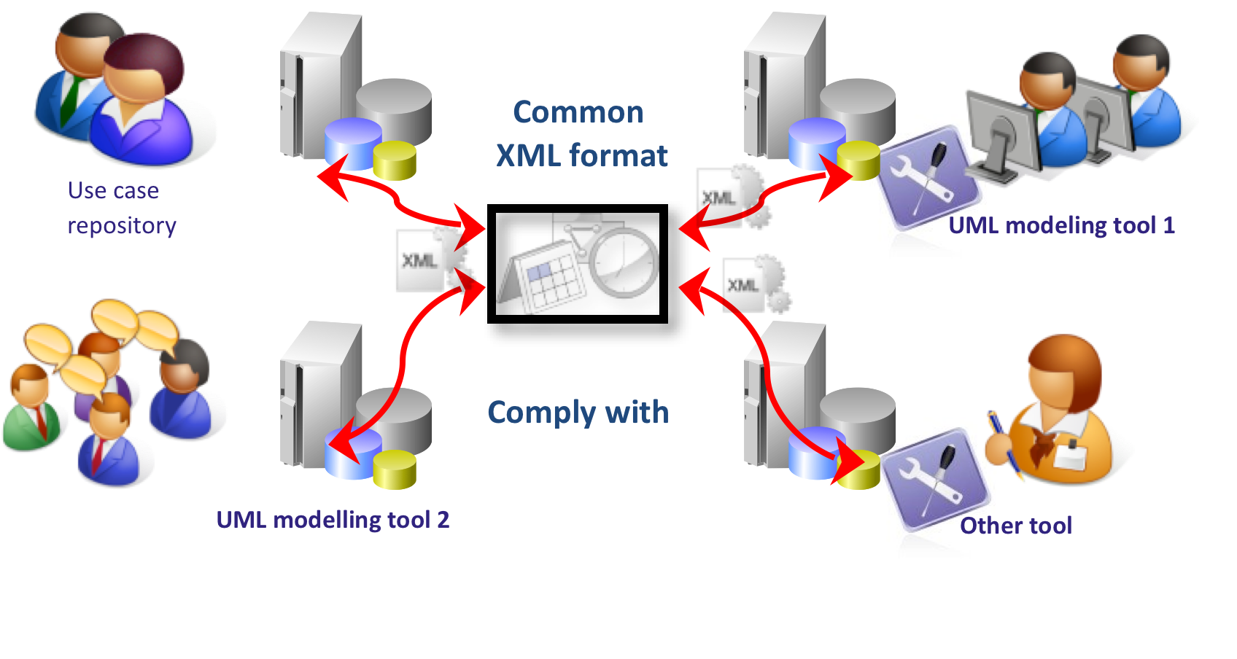
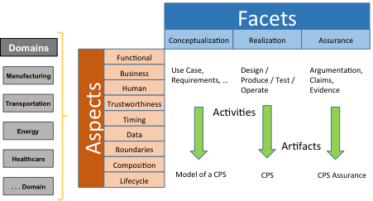
A Union of Technologies
IEC 62559 Use Case Methodology
NIST CPS Framework Methodology
Standardized XML Schema
Use Case
Requirements
Design
Assurance
Business Case
Conceptualization
Realization
Traceability to Requirements
Algorithmically Prove Design Meets Requirements

Slide 71








Framework Open Source Project
Continuous Integration Approach for CPS Development
Common
XML format –
Model of CPS
CPS and
Assurance of CPS
CPS Framework Use Case/Aspects/Concerns Analysis
Requirements modeling tool
Design Verification and Validation and Assurance Tools
Design Exploration / Model Driven Development / Continuous Integration Tools
https://github.com/usnistgov/cpsframework

Slide 72
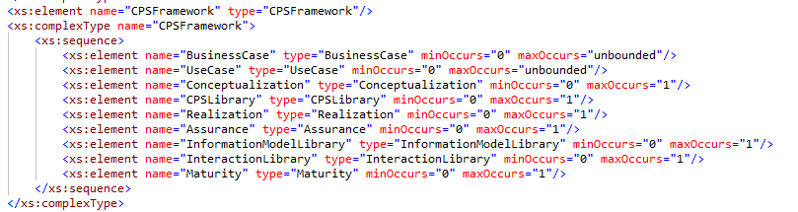
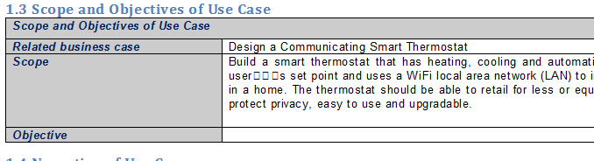
Methodology
Capture the CPS Framework in UML
Class hierarchy of facets, aspects, concerns, …
Functional decomposition based on an IEC Use Case standard
Generate an XMLSchema of the model
Which governs an XML instance document of a CPS Framework
Produce a test example CPS, e.g. a smart communicating thermostat

Slide 73
Use Case Methodology

Slide 74
IEC 62599 Standard
What Is A Use Case?
IEC 62599 Standard - Use Case Methodology
IEC 62599-2 Standard - Template Format for Use Case
Benefits of Standard-based Use Case
Notes:
Thanks, Marty.
Good afternoon, Everybody!
I will talk about IEC 62599 std-based Smart Thermostat.
First, I will talk about what is a use case, concept
second, I will introduce IEC 62599 standard, which focuses on use case methodology
next, Talk about 62599-2 template for use case
Then, I provide an example of Smat Thermostat use case based on 612599-2 template
In the end, I will address benefits of standard-based use case methodology

Slide 75
What Is A Use Case?
A use case is an abstraction of a function of a system.
A use case is a specification of a set of actions performed by a system. (ISO/IEC 19505-2:2012)
Use cases are used to capture functional requirements of a system.
Example:
Smart thermostat
has heating, cooling and automatic control modes (three actions) to control HVAC system to maintain room temperature near a user’s set point
Notes:
It describe system requirements and functions.
Definition: the specification of a set of actions performed by a system. (ISO/IEC 19505-2:2012)
Use cases are a type of textual requirements specification that capture how a user will interact with a solution to achieve a specific goal.
Use cases are perhaps the best way to capture functional requirements of a system.
Use case is the best way to capture functional requirements of a system.
For example:
Design a smart thermostat to maintain room temperature near a user’s set point (78ºF) within 76ºF ~ 80ºF
For the same use case, this is only one description of smart thermostat use case.
However, different persons may have different descriptions of the same use case.
The challenge or problem we are facing is how to share or exchange of the same use case?
One of solutions to solve this problem is to standardize use case format,
next, I will introduce IEC 62599 standard – use case methodology

Slide 76
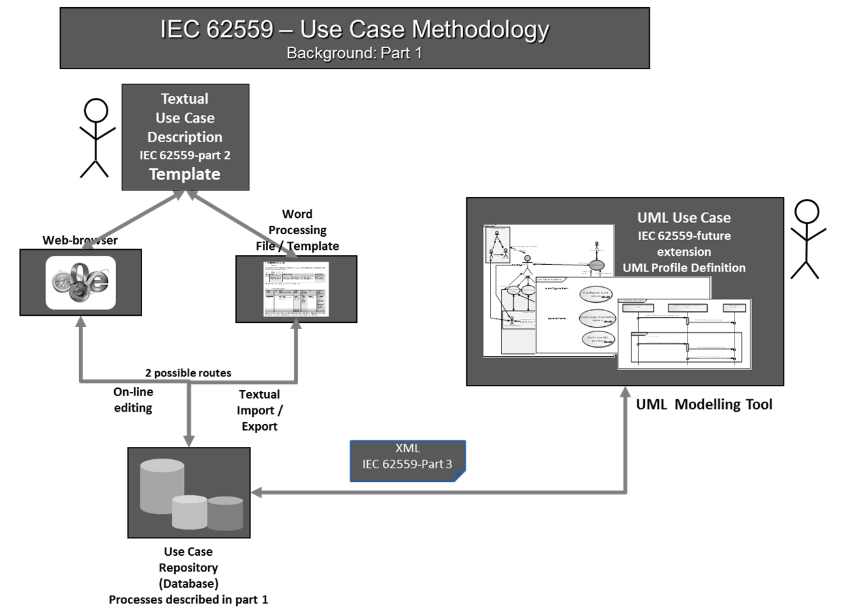
IEC 62559 - Use Case Methodology
IEC 62559 - Use Case Methodology:
Part 1 – Concept and processes in standardization
Part 2 – Definition of a template format for use cases, actor list and requirements list
Part 3 – UML Model and XML Serialization of use case template artifacts
Notes:
IEC 62599 - Use Case Methodology:
Part 1 – Concept and processes in standardization
Part 2 – Definition of Template format for use case
Part 3 – UML Model and XML Serialization

Slide 77
IEC 62559-2 - Template Format for Use Case
Description of the use case
Diagrams of use case
Technical details
Step by step analysis of use case
Information or energy exchanged
Requirements (optional)
Common terms and definitions
Custom information (optional)
Diagram of use case
Notes:
The standard template includes eight parts in the following:
Description of the use case
Diagrams of use case
Technical details
Step by step analysis of use case
Information exchanged
Requirements (optional)
Common terms and definitions
Custom information (optional)
Sine we know the template of use case, next I talk about example of use case:

Slide 78
2. Diagram of Smart Thermostat Use Case
IEC 62559-2 Standard Example - Smart Thermostat Use Case
Information exchanged
Temperature
Sensor
Temperature
Set point
Temperature
Smart Thermostat
User
Thermostat
Controller
HVAC System
Status
Compressor
HVAC
Controller
Control
Fan
Furnace
Actors
Notes:
Four Actors:
User
Thermostat controller
Temperature sensor
HVAC system (Compressor, Fan, and Furnace)
Four Information exchanged :
Temperature set point
Temperature
Status
control

Slide 79
IEC 62559-2 Standard-based Smart Thermostat Use Case (Cont’d)
5 Information Exchanged
Information exchanged ID | Name of information | Description of information exchanged | Requirements IDs
Temperature | Temperature | Float temperature value
TemperatureSetPoint | Temperature | Float temperature value
Control | Control | Control: 1 = On, 0 = Off Example:
Status | Status of HVAC | Contains the current status of the HVAC: 0 = Off, 1 = On Example:
Cool | Fun | Heat
0 | 0 | 0
Cool | Fun | Heat
1 | 1 | 0
Notes:
Information exchanged:
Temperature - temperature
TemperatureSetPoint – user input
Control – control command [cool, fun, heat]
Status – HCAV system status [cool, fun, heat]
0- off
1- on
Each information has:
Information exchanged ID
Name of information
Description of information exchanged
Requirements IDs

Slide 80
Benefits of a Standard-based Use Case Methodology
provide a standardized format and common understanding of use cases, including functionalities, actors and interactions of CPS
help to easily understand functions and requirements of CPS
help to easily exchange or share of use cases among CPS development processes
Notes:
Benefits:
easy to understand the functions of system.
support a common understanding of use cases (functionalities, actors and processes).
ensure that the correct system is developed by capturing the requirements and functions of system (?)
manage the complexity of large projects by decomposing the problem into major functions (?)
easy to automatically transformations among CPS system development processes
Power energy industry has created a number of use case using this approach
I have discussed:
•use case concept
•Introduced IEC 62599 std
•Described 62599-2 template
•Provided Example of std-based use case – smart thermostat
•Addressed benefits of std-based use case methodology
Next:
Marty will talk about Life cycle of CPS development using modeling tool, including how to convert this use case into UML model and XML format

Slide 81
Model Realization

Slide 82
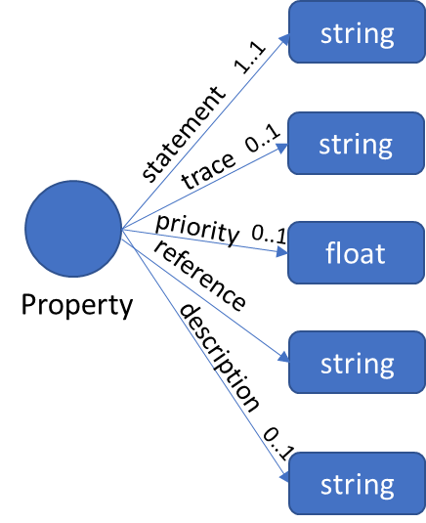
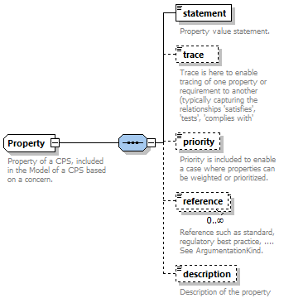
CPS Framework Modeling Tools
OWL
UML
XSD
Reasoning and Assessments
owl:sparql
CPS Assurance and Code-Generation
CPS
Relate Concerns to Structure
xml:xsd

Slide 83
NIST CPS Framework
‘Concern-driven’: holistic, integrated approach to CPS/IoT concerns.
CPS Framework Release 1.0 (May2016) available at https://pages.nist.gov/cpspwg/

Slide 84
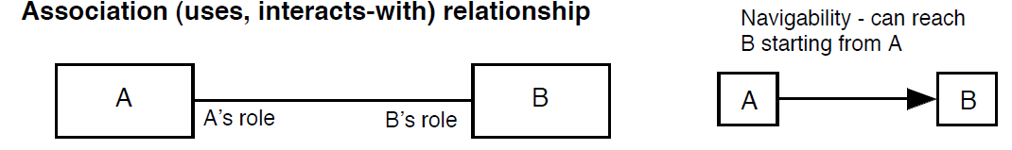
Crash course in UML
Class
Inheritance (is-a) relationship
Aggregation and Composition (has-a) relationship
Name
Base
Whole
Whole
Whole
Attributes (member variables)
Derived2 is-a Base
Part is independent
Part is dependent
Whole has a Part
Methods (member functions)
Derived1
Derived2
Part
Part
Part
A
1
0..*
B
B is associated with one A
A is associated with 0 or more B
Multiplicity in Aggregation, Composition, or Association
* - any number 0..1 - zero or one
1 - exactly 1
1..* - 1 or more
n - exactly n
n .. m - n through m

Slide 85
Modeling the CPS Framework and Use Cases

Slide 86
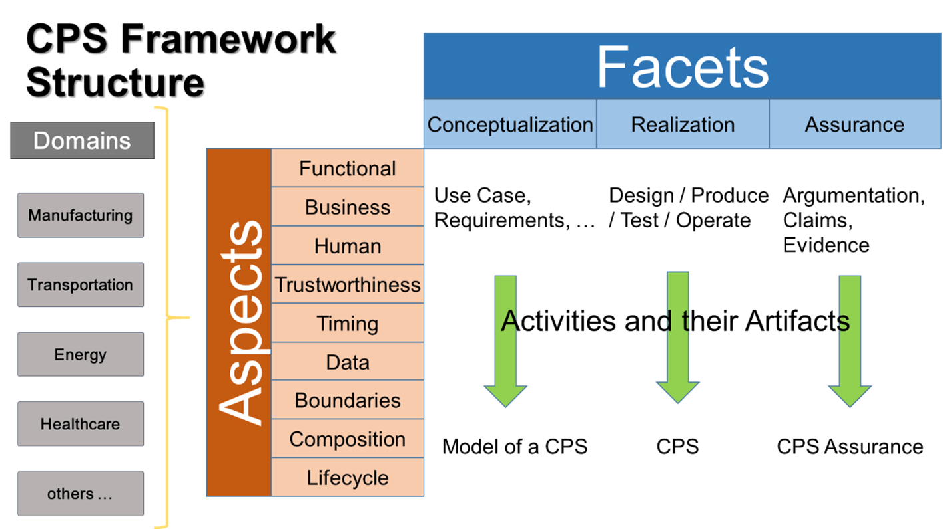
CPS Framework Object Model in UML
**See Aspects on subsequent slide

Slide 87
CPS Framework Aspects
From functional decomposition
**Each Aspect has a hierarchically arranged set of concerns

Slide 88
CPS Functional Decomposition
CPS/Function Types
Business Case
Use Case
‘feature’
CPS
Functional Decomposition/Allocation
Logical
Message
Info
Physical
Influence
Energy

Slide 89
Allocation of Aspects to Model Elements
Note how each major component of functional decomposition can have apportionment of Aspects and Concerns, including Trustworthiness

Slide 90
Aspects and Concerns

Slide 91
Concerns and Properties
Properties, like requirements, are assertions intended to address a concern and evaluate to true or false to facilitate testing and verification
Instance of Aspects/Concerns tree
Properties define the requirements that address a concern
Concerns are grouped hierarchically beneath Aspects
Property is defined as containing:
statement: a requirements-like assertion that is either true or false
trace: a reference to another Property elsewhere in the graph
priority: a priority to be used to referee competing properties
reference: a reference such as a standard, regulatory or best practice
description: a more elaborate description of the statement

Slide 92
Model of a Facet: a collection of process activities
CPS are conceived and build in order to address certain needs while addressing any concerns the stakeholders may have. There will be activities, or sets of activities, with well-defined outcomes or deliverables that are designed to fulfill those needs and, at the same time, address stakeholder concerns.
[Artifact]
[Activity]
[Aspect/Concern]

Slide 93
Process Element Depiction of CPS Framework Facets
Model of CPS
Conceptualization Activities
CPS
Realization Activities
Conceptualization Facet
Realization Facet
CPS Assurance
Assurance Activities
Assurance Facet

Slide 94
Facets

Slide 95
Activities: Conceptualization Facet

Slide 96
Activities: Realization Facet

Slide 97
Activities: Assurance Facet

Slide 98
Maturity and Versioning

Slide 99
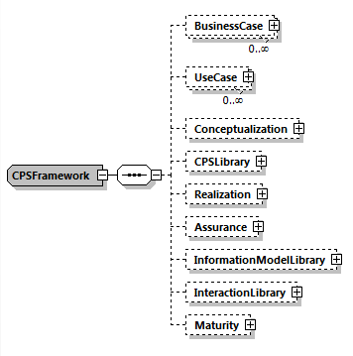
Turn the crank to generate the XML Schema
Model in UML
Model in XMLSchema
Code Engineering / Generate XML Schema
Sparx Systems Enterprise Architect V13.5
Revise to optimize schema
Altova XMLSpy 2017

Slide 100

XML Editor of a Use Case

Slide 101


CPS Framework in XML Schema

Slide 102

CPS Framework Instance: Trustworthy Thermostat

Slide 103
Tools Demonstration
UML Model Review
XSD Export and Review
XML Model Browse
XSLT (text view vs browser view)
Xpath (//*/Aspects/trustworthiness/*/Property/..)

Slide 104
CPS Framework Ontology – Balduccini/Vishik
Use-Cases, Formalization and
Reasoning Examples

Slide 105


Progress

Slide 106
Progress
To do:
Review choices with team
Create graph(s) for the ontology
Create graph(s) for constraints/dependencies/trade-offs
Update prototype
Replace screenshots
Multiple levels of decomposition
Querying for all properties for a given concern, at all levels of decomposition

Slide 107

Goals
Demonstrate
Formalization of CPS Model and surrounding domain
Formalization of attacks, their effects, mitigation actions
Reasoning about aspects, concerns, properties
Recursive traversal of concern trees
Reasoning about physical ramifications
Finding mitigations, reasoning about their effects

Slide 108
Formalization

Slide 109
Goals of the Formalization
Capture relevant knowledge about a CPS
CPS-independent: Aspects/Concerns hierarchy
CPS-specific: Properties
Constraints, dependencies, tradeoffs
General-purpose, e.g. thermodynamics
CPS-specific, e.g.:
Component dependencies
Property dependencies
Effects of malware
Enable reasoning about:
The current state of the CPS
Both logical and physical
Which Properties are violated
Which Aspects/Concerns are currently satisfied
How to reach a desired state
Recovery to mission capability

Slide 110



Proposed Formalization Components
Within CPS Framework

Slide 111


Proposed Formalization Components
Beyond CPS Framework
One conclusion: negative interaction between confidentiality and functionality

Slide 112
Generalized Integrated Monitoring & Control System Can be specialized into any of the example systems discussed later
“Generalized” components circled in red
Physical connection
Direct logical connection
text
Description of interaction
text
Annotation
operating environment
Physical element
o1
Influence: config change
Energy: mechanical
f1a
Influence: TBD
f1b
Influence: TBD
Logical element
Physical & logical system
cmd1
Message: command packet
Information: type of warning, attributes
reconfig
mech
input1
input2
indicator
f2b
Message: byte seq.
Information: feed
contains f1b
configurable
input
remote station
f2a
Message: byte seq.
Information: feed
contains f1a
SAM
cmd2
Message: command packet
Information: new config
notification1
Message: notification packet
Information: type of notification, timestamp, location, user ID
user
combof1
Message: byte seq.
Information: combined input feeds
contains f2a
contains f2b
integrated monitoring & control system (stand-alone part)
storage
us1
Influence: user signal
combof2
Influence: audio, video, other signals
integrated monitoring & control system
recipient

Slide 113
Aspects, Concerns, Properties for Generalized Integrated Monitoring & Control System
Trustworthiness Elements
Safety
Reliability
Security
Physical security
Confidentiality
Integrity
Availability
Privacy
Resilience
Cybersecurity
Functionality
Functional
Timing
Time-interval and latency control
Note: unless otherwise specified, “camera” refers to both basic and advanced camera
Aspects
Concerns
Input Device 1 should be capable of operating in low-speed mode and in high-speed mode
SAM uses secure boot
Input Device 1 uses secure boot
Input Device 1 maintains consistent frequency of readings
SAM uses encrypted memory
Input Device 1 uses encrypted memory

Slide 114

Summary of Examples
Simplified “Body Camera”
Camera
SAM
Minimal assumptions on knowledge about connections
Link to broader domain: admissibility of video in court
Self-Driving Car (a)
Camera
SAM
Broader domain: consequences on car’s operations
Self-Driving Car (b)
Sensors
SAM
Broader domain: consequences on car’s operations

Slide 115
Example 1 Body Camera
An integrated body security system for situational awareness and safety of security personnel

Slide 116
Example 1 “BodyCam” Diagram
Physical connection
Direct logical connection
text
Description of interaction
text
Annotation
Physical element
Logical element
operating environment
Physical & logical system
o1
Influence: angle change
Energy: mechanical
vf1
Influence: video signal
Energy: electr. waves
af1
Influence: audio signal
Energy: sound waves
cmd1
Message: command packet
Information: type of warning, attributes
targeting
mech
camera
mic
indicator
af2
Message: byte seq.
Information: audiofeed
contains af1
encoding AES
robotic camera
command center
vf2
Message: byte seq.
Information: videofeed
contains vf1
encoding AES
SAM
alarm1
Message: alarm packet
Information: type of alarm, timestamp, location, officer ID
cmd2
Message: command packet
Information: degrees, speed
officer
avf1
Message: byte seq.
Information: combined videofeed, audiofeed
contains vf2
contains af2
encoding AES
integrated body security system (stand-alone part)
storage
ws1
Influence: warning signal
Energy: waves TBD
avf2
Influence: audio-video signal
Information: sound, light waves
integrated body security system
court

Slide 117

Example 1 Simplified “BodyCam”
Actors
Camera
Basic camera
Advanced camera
Two modes:
Record at 25 fps
Record at 50 fps
Security features (may be enabled)
Encrypted memory
Secure boot
SAM (Situational Awareness Module)
SAM controls the recording rate
MUST UPDATE AFTER DIAGRAM IN PREVIOUS SLIDE IS CHECKED

Slide 118
Aspects, Concerns, Properties
Trustworthiness Elements
Safety
Reliability
Security
Physical security
Confidentiality
Integrity
Availability
Privacy
Resilience
Cybersecurity
Functionality
Functional
Timing
Time-interval and latency control
Note: unless otherwise specified, “camera” refers to both basic and advanced camera
Aspects
Concerns
Camera should be capable of recording at 25 fps or at 50 fps
SAM uses secure boot
Camera uses sec. boot
SAM uses encrypted memory
Camera uses encrypted memory
Camera does not drop frames

Slide 119

Formalization
Aspect/Concern Trees
Trustworthiness Elements
Safety
Reliability
Security
Physical security
Confidentiality
Integrity
Availability
Privacy
Resilience
Cybersecurity
Functionality
Functional
Timing
Time-interval and latency control
Aspects
Concerns

Slide 120

Formalization
Aspect/Concern Trees
Trustworthiness Elements
Safety
Reliability
Security
Physical security
Confidentiality
Integrity
Availability
Privacy
Resilience
Cybersecurity
Functionality
Functional
Timing
Time-interval and latency control
Aspects
Functionality Concern
MUST UPDATE ENCODING AND SCREENSHOTS
Camera will not drop frames
Concerns

Slide 121
Formalization
Aspect/Concern Trees
Trustworthiness Elements
Safety
Reliability
Security
Physical security
Confidentiality
Integrity
Availability
Privacy
Resilience
Cybersecurity
Functionality
Functional
Timing
Time-interval and latency control
Aspects
Functionality Concern
MUST UPDATE ENCODING AND SCREENSHOTS
Camera will not drop frames
Concerns
Integrity Concern
MUST UPDATE ENCODING AND SCREENSHOTS
SAM is capable of using secure boot
Camera is capable of using sec. boot

Slide 122

Example 1
System Configuration
SAM and camera use encrypted memory and secure boot
Basic camera is used
Recording rate set at 25 fps by SAM
MUST UPDATE

Slide 123

Example 1
MUST UPDATE

Slide 124
Example 1
MUST UPDATE
System Configuration
SAM and camera use encrypted memory and secure boot
Basic camera is used
Recording rate set at 25 fps by SAM
Questions
Is the integrity concern satisfied?

Slide 125

Example 1
System Configuration
SAM and camera use encrypted memory and secure boot
Basic camera is used
Recording rate set at 25 fps by SAM
Questions
Is the integrity concern satisfied?
Outcome of the reasoning process:
MUST UPDATE
Trustworthiness concern tree (fragment)
Integrity concern is satisfied

Slide 126
Example 1
System Configuration
SAM and camera use encrypted memory and secure boot
Basic camera is used
Recording rate set at 25 fps by SAM
Questions
Is the trustworthiness aspect satisfied?
Outcome of the reasoning process:
Trustworthiness concern tree
Trustworthiness aspect is satisfied

Slide 127
Example 1
System Configuration
SAM and camera use encrypted memory and secure boot
Basic camera is used
Recording rate set at 25 fps by SAM
Questions
Are all aspects satisfied?
Outcome of the reasoning process:
MUST UPDATE
Trustworthiness concern tree
All aspects are satisfied

Slide 128

Example 1
MUST UPDATE
Also tested:
Adding properties for timing aspect
Elaborating other properties
Manually disabling encrypted memory, secure boot on SAM and/or camera
Asking questions about functional, timing aspects and their concerns

Slide 129


Example 1 – Step 2
System Configuration
SAM and camera use encrypted memory and secure boot
Basic camera is used
Recording rate set at 25 fps by SAM
A cyberattack occurs and hacks the SAM to activate recording at 50 fps
MUST UPDATE

Slide 130


Example 1 – Step 2
System Configuration
SAM and camera use encrypted memory and secure boot
Basic camera is used
Recording rate set at 25 fps by SAM
A cyberattack occurs and hacks the SAM to activate recording at 50 fps
Questions
Is the integrity concern satisfied?
Outcome of the reasoning process:
MUST UPDATE
Trustworthiness concern tree (fragment)
MUST UPDATE
Integrity concern is not satisfied

Slide 131
Example 1 – Step 2
System Configuration
SAM and camera use encrypted memory and secure boot
Basic camera is used
Recording rate set at 25 fps by SAM
A cyberattack occurs and hacks the SAM to activate recording at 50 fps
Questions
Is the trustworthiness aspect satisfied?
Outcome of the reasoning process:
Trustworthiness concern tree
MUST UPDATE
No

Slide 132
Example 1 – Step 2
System Configuration
SAM and camera use encrypted memory and secure boot
Basic camera is used
Recording rate set at 25 fps by SAM
A cyberattack occurs and hacks the SAM to activate recording at 50 fps
Questions
What happens in the environment?
Outcome of the reasoning process:
The recording is thrown out of court
because data integrity was violated
MUST UPDATE
Conclusion based on the knowledge:

Slide 133




Example 1 – Step 3
System Configuration
SAM and camera use encrypted memory and secure boot
Basic camera is used
Recording rate set at 25 fps by SAM
A cyberattack occurs and hacks the SAM to activate recording at 50 fps
Questions
How can it be mitigated?
Mitigation Generation Module:

Slide 134


Example 1 – Step 3
System Configuration
SAM and camera use encrypted memory and secure boot
Basic camera is used
Recording rate set at 25 fps by SAM
A cyberattack occurs and hacks the SAM to activate recording at 50 fps
Questions
How can it be mitigated?
Outcome of the reasoning process:
MUST UPDATE
“Replace basic camera with
advanced camera”
All aspects are satisfied

Slide 135
Example 2 Self-Driving Car (a)
A self-driving car uses SAM and camera for lane keeping/assist

Slide 136
Example 2 Self-Driving Car (a)
Physical connection
Direct logical connection
text
Description of interaction
text
Annotation
Physical element
Logical element
operating environment
Physical & logical system
o1
Influence: angle change
Energy: mechanical
vf1
Influence: video signal
Energy: electr. waves
af1
Influence: audio signal
Energy: sound waves
cmd1
Message: command packet
Information: type of warning, attributes
targeting
mech
camera
mic
indicator
af2
Message: byte seq.
Information: audiofeed
contains af1
encoding AES
robotic camera
remote assit
vf2
Message: byte seq.
Information: videofeed
contains vf1
encoding AES
SAM
alarm1
Message: alarm packet
Information: type of alarm, timestamp, location, driver ID
cmd2
Message: command packet
Information: degrees, speed
driver
avf1
Message: byte seq.
Information: combined videofeed, audiofeed
contains vf2
contains af2
encoding AES
integrated lane keeping/assist system (stand-alone part)
storage
ws1
Influence: warning signal
Energy: waves TBD
ctrl1
Message: angle change
Information: mechanical
integrated lane keeping/assist system
steering wheel

Slide 137

Example 2: Self-Driving Car (a)
A self-driving car uses SAM and camera for lane keeping/assist
Actors
Camera
Basic camera
Advanced camera
Two modes:
Record at 25 fps
Record at 50 fps
Security features (may be enabled)
Encrypted memory
Secure boot
SAM (Situational Awareness Module)
SAM controls the recording rate
MUST UPDATE
engine
control

Slide 138


Example 2: Self-Driving Car (a)
System Configuration
SAM and camera use encrypted memory and secure boot
Basic camera is used
Recording rate set to 25 fps by SAM
A cyberattack occurs and hacks the SAM to activate recording at 50 fps
Questions
Is the integrity concern satisfied?
Is the trustworthiness aspect satisfied?
What are the physical ramifications?
How can it be mitigated?
MUST UPDATE
MUST UPDATE
Conclusion based on the knowledge:
MUST UPDATE
“Replace the basic camera with the advanced camera”

Slide 139
Example 3 Self-Driving Car (b)
A self-driving car uses SAM and sensors for adaptive cruise control

Slide 140
Example 2 Self-Driving Car (b)
Physical connection
Direct logical connection
text
Description of interaction
text
Annotation
Physical element
Logical element
operating environment
Physical & logical system
o1
Influence: angle change
Energy: mechanical
vf1
Influence: video signal
Energy: electr. waves
af1
Influence: audio signal
Energy: sound waves
cmd1
Message: command packet
Information: type of warning, attributes
targeting
mech
sensor
mic
indicator
af2
Message: byte seq.
Information: audiofeed
contains af1
encoding AES
robotic sensor
remote assit
vf2
Message: byte seq.
Information: feed
contains vf1
encoding AES
SAM
alarm1
Message: alarm packet
Information: type of alarm, timestamp, location, driver ID
cmd2
Message: command packet
Information: degrees, speed
driver
integrated adaptive cruise control system (stand-alone part)
avf1
Message: byte seq.
Information: combined feeds
contains vf2
contains af2
encoding AES
storage
ctrl1
Influence: angle change
energy: mechanical
ctrl2
Influence: angle change
energy: mechanical
ws1
Influence: warning signal
Energy: waves TBD
integrated adaptive cruise control system
accelerator
brake

Slide 141
Example 3: Self-Driving Car (b)
A self-driving car uses SAM and sensors for adaptive cruise control
Actors
Sensors
Interpolating sensors (inaccurate hardware, interpolation compensates)
Non-interpolating sensors (accurate hardware)
SAM (Situational Awareness Module)
SAM requests sensor readings either at low rate or high rate
In interpolating sensors:
High request rate causes interpolation to be cut short
Potentially leads to inaccurate data returned to SAM

Slide 142
Example 3: Self-Driving Car (b)
System Configuration
SAM and sensors use encrypted memory and secure boot
Interpolating sensors are used
SAM requests sensor readings at low rate
Questions
Is the integrity concern satisfied?
Is the trustworthiness aspect satisfied?
Are all aspects satisfied?

Slide 143

Example 3 – Step 2
System Configuration
SAM and sensors use encrypted memory and secure boot
Interpolating sensors are used
SAM requests sensor readings at low rate
A cyberattack occurs and hacks the SAM to request readings at a high rate
Questions
Is the integrity concern satisfied?
Is the trustworthiness aspect satisfied?
What are the physical ramifications?
Conclusion based on the knowledge:

Slide 144

Example 3 – Step 3
System Configuration
SAM and sensors use encrypted memory and secure boot
Interpolating sensors are used
SAM requests sensor readings at low rate
A cyberattack occurs and hacks the SAM to request readings at a high rate
Questions
Is the integrity concern satisfied?
Is the trustworthiness aspect satisfied?
What are the physical ramifications?
How can it be mitigated?
MUST UPDATE
MUST UPDATE
Mitigation Generation Module
“Replace interpolating sensors
with non-interpolating ones”

Slide 145
Example 3 (Variant) Multiple Possible Mitigations

Slide 146



Example 3 – Step 3 (Extended)
System Configuration
SAM and sensors use encrypted memory and secure boot
Interpolating sensors are used
SAM requests sensor readings at low rate
A cyberattack occurs and hacks the SAM.
Unless a patch is applied, the SAM will request readings at a high rate.
Questions
Is the integrity concern satisfied?
Is the trustworthiness aspect satisfied?
What are the physical ramifications?
How can it be mitigated?
MUST UPDATE
Solution #1
Effect of mitigation
MUST UPDATE
Solution #2
“Patch the SAM”

Slide 147
Conclusions
Demonstrated
Formalization of CPS Model and surrounding domain, attacks, mitigations
Reasoning about concerns, properties, physical ramifications
Finding (multiple) mitigations, reasoning about their effects
Three examples: “BodyCam”, Self-driving Car (a & b)
Next Steps
Standardization of modeling of surrounding domain, attacks, mitigations
Parametrization of properties
Formalization, leverage of knowledge about CPS structure

Slide 148
Building Community around Trustworthiness
What are the hoped-for outcomes
Collaboration Tools – GitHub Environment
Embedding this technology in your CPS Engineering Tool
Open Discussion on Next Steps

